Slide 1

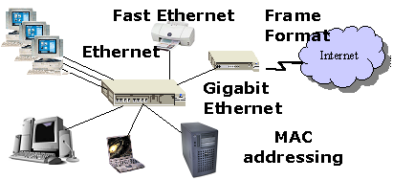
OSNF
LECTURE
Ethernet Switching
PART 2
Diploma in CSF/IT
Year 1 (2021/22), Semester 2
Notes:
Left-hand Bar – Replace FSP by your module code and X by the lecture number.
Replace Lecture Title
Replace < Module Name >
Replace Year and Semester if necessary

Slide 2
Objectives
At the end of this, you will be able to:
Understand Basic Switch Operation

Slide 3
TCP/IP Protocol Suite
It defines …
Protocol Layer
Application
HTTP, SMTP, DNS, FTP etc.
TCP, UDP etc.
Transport
Internet
IP (IP Addressing)
Network Interface
Data Link
Physical
Ethernet, Wireless LAN
Transmission Medium (e.g. UTP, Coaxial, Fibre, Wireless)

Slide 4

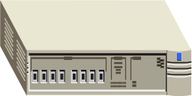

Overview of LAN Switching
A switch receives a frame transmitted by the NIC of a host and forwards it to the NIC of the destination host.
The switch knows how to forward the frame based on the Destination MAC Address in the frame header.
Data for Frame

Slide 5
Principles of LAN Switching
A LAN switch connects different hosts together to form a local area network.
It operates in the following modes:
Learning
Flooding
Forwarding
Filtering (Optional)
Ageing (Optional)

Slide 6
Learning
When a switch first starts operation, its source MAC Address table is empty.
As frames arrive at the switch ports, the switch reads the content of the frame to obtain the Destination MAC address, Source MAC address and other information.
The Source MAC address is used to populate the MAC Address Table.
  A MAC address table, also called a switching table, is used on Ethernet switches to determine where to forward traffic on a LAN.
Data for Frame

Slide 7
Learning
MAC Address Table
To Mac Addr | Use Port:
AAAAAA | 1
DDDDDD | 6
Switch
Port 1
Port 6
PC 1
PC 4
MAC addr AAAAAA
MAC addr DDDDDD

Slide 8

Flooding
PC 1
PC 2
MAC addr AAAAAA
MAC addr BBBBBB
MAC addr CCCCCC
MAC addr DDDDDD
PC 3
1 2 3 4 5 6 7 8
PC 4
Destination DDDDDD not found in MAC Address Table
To Mac Addr | Use Port:
AAAAAA | 1
The switch will forward the frame to all other ports – flooding.
Notes:
PC 4 received the frame and sends a frame destined for PC 1

Slide 9
Forwarding
Switch receives a frame from PC 4, it searches the switch table to find an entry that matches the MAC address AAAAAA.
A match is found, the frame would be forwarded via the corresponding port.
To Mac Addr | Use Port:
AAAAAA | 1
DDDDDD | 6
Switch
Port 1
Port 6
PC 1
PC 4
MAC addr AAAAAA
MAC addr DDDDDD

Slide 10
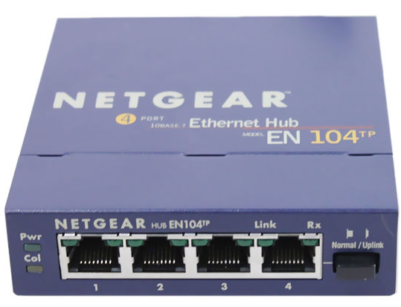
Filtering (Optional)
Frames are never forwarded out of the port they are received on.
PC 4 is sending a frame to PC 5 though a Hub;
The hub copies the frame to all its port;
PC 5 receives the frame;
Switch drops the frame because the source and destination addresses are from the same port.
To Mac Addr | Use Port:
AAAAAA | 1
DDDDDD | 6
EEEEEE | 6
MAC addr DDDDDD
1 2 3 4 5 6 7 8
PC 4
Drop packets with Destination
Address of PC 4 and 5
MAC addr EEEEEE
PC 5
Hub

Slide 11
Ageing (Optional)
The addresses learnt dynamically in the MAC Address Table undergo ageing.
After a period of time, if no new frames for a MAC Address Table entry is seen by the switch, that mapping for that address will be removed by the switch
To Mac Addr | Use Port:
AAAAAA | 1
DDDDDD | 6
EEEEEE | 6 (not seen for 5 mins)
To Mac Addr | Use Port:
AAAAAA | 1
DDDDDD | 6

Slide 12
Final Notes on Switching
Ethernet broadcast MAC address is FF-FF-FF-FF-FF-FF (all 1’s)
  Switches will forward a frame has a destination address of ff-ff-ff-ff-ff-ff to all its other ports (without searching the switch table).
  Note that this is not the same as flooding although the frame is also forwarded to all the other ports of the switch.

Slide 13
END

